Slide 1
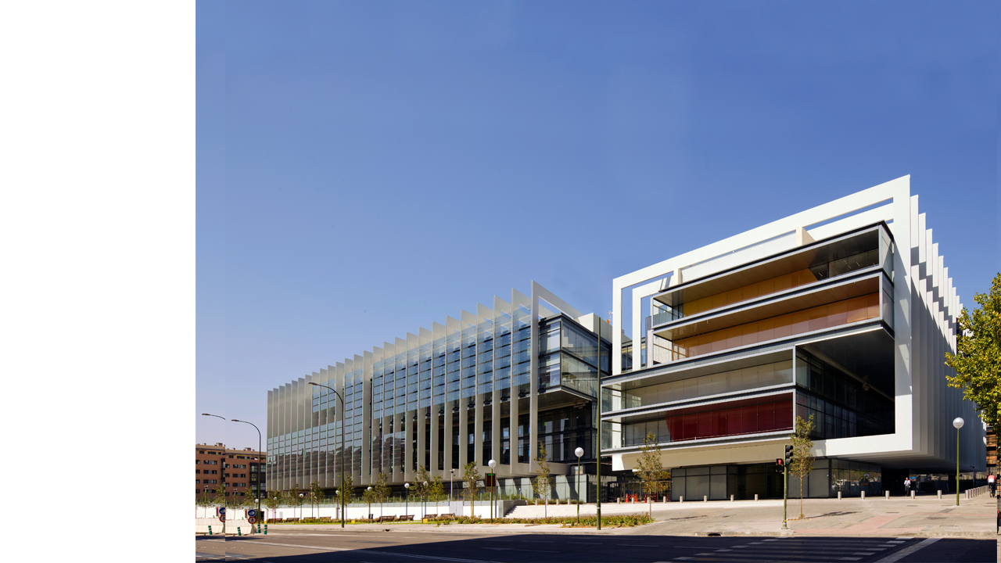
Integrate people with disabilities in any work environment:
office or industry
Moscow
October 23rd, 2020
Notes:
Good afternoon everyone,
First of all, on behalf of Repsol and on my own behalf, I would like to thank the Zero projects leaders for promoting this conference and for the wishes to foster the Disability integration in the Workplace.
What I want to share with you today is the experience of Repsol about the development of a workforce culture that is respectful and inclusive; promoting the hiring, retention and professional development of people with disabilities, and how this project allow us to evolution in people management.

Slide 2
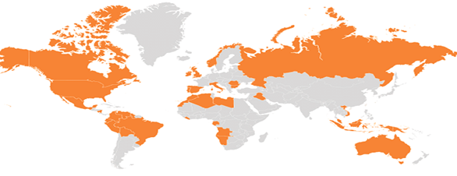
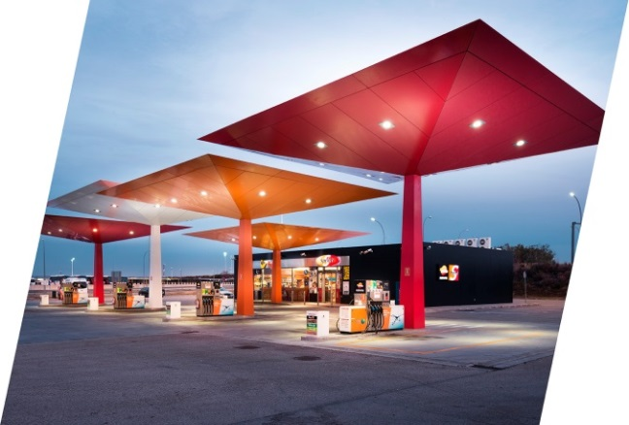
REPSOL: global integrated
energy company
27,000 employees of over 80 nationalities
in more than 40 countries
Search
Transformation
Energy for daily use
Notes:
Repsol is an energy company, present in key areas with the greatest potential on the global energy map.
We are present throughout the oil and gas value chain, engaging in operations that range from exploration and production to the development and commercialization of energy solutions.
We are a diverse and committed team with over 27,000 employees of 80 different nationalities present in over 40 countries.

Slide 3
What value does it bring?
Mission and values
At Repsol we want to be a global company seeking the well-being of people and leading the way in building a better future through the development of intelligent energy with effort, talent and enthusiasm, we are moving forward to offer the best energy solutions for society and the planet.
Respect
Cultural
values
Sense of
anticipation
Integrity
Responsibility
Transparency
Flexibility
Innovation
Trust
Notes:
Over the last 10 years, we've driven a transformation process that has enabled us to achieve a global company model with an international focus, that is innovative, responsible, and renowned, that supplies energy to millions of people.
This is the basis on which we drive the development of the company's future, a vision that puts value in society and its future.
The Policy of respect towards people and diversity is the basis of our vision. By building upon it, we have created the foundation of a company that carries out its activities while promoting fair and equal treatment of all members of its organization, under the principle of Equal Opportunities.

Slide 4
Why diversity & inclusion are important?
Today, managing diversity goes far beyond of just ‘doing the right thing’.
Companies with high diversity levels are showing the notably higher effectiveness than the peers:
Better financial results
Innovation drive
Talent attraction
Employee commitment
Better reputation
Client orientation

Slide 5
Our objective: pass from integration to true inclusion

Slide 6
People with disabilities in the world
1
BILLION
PEOPLE
LIVE WITH DISABILITY
Fuente: World Health Organizations and World Bank. World Report on Disability

Slide 7
Key success factors in the inclusion of people with disabilities
Awareness and personal conviction
Adapt position to the employee´s capabilities
Partner with leading experts
Ensure equal opportunities
Anticipate needs
Recruitment, onboarding and ongoing assessment
Support from senior management
Strong coordination of all areas involved (Labor relations, Unions, Medical Services, Safety, etc.)
Notes:
This is not Charity, the integration must be conectted to Business targets
Talent escarcity: The conditions in this context is that we are having problems to attract people, great attrition, to EESS
When you go to an industrial context you must review processes and task how to adapt.
Another

Slide 8
Evolution of contracting
staff with disabilities
617
3.66%
788
Direct contracting
Spain
Direct contracting + indirect employment
in Spain
Direct contracting
Worldwide
3,16%
Notes:
This is our Data
Repsol currently has a mainstreaming integration program for people with disabilities in all areas of the organization. At the end of last year, we already had 617 employees with disabilities working for us in Spain (LGD data, December 2015), which represents 3.16% of our workforce (2% law requires).
Of those, 27% are in technical roles, both in our central services such as industrial refineries and sales offices. This participation is particularly visible in contact with the public, such as the network of our service stations. Furthermore, as of December, 2015, we have 4,25% of employees with disabilities in Ecuador, 3,2% in Brazil, 1,5% in Italy, 1,4% in Venezuela and Peru and 1% in Portugal (But specifically in Oil Stations we have 3%) and in Russia.

Slide 9
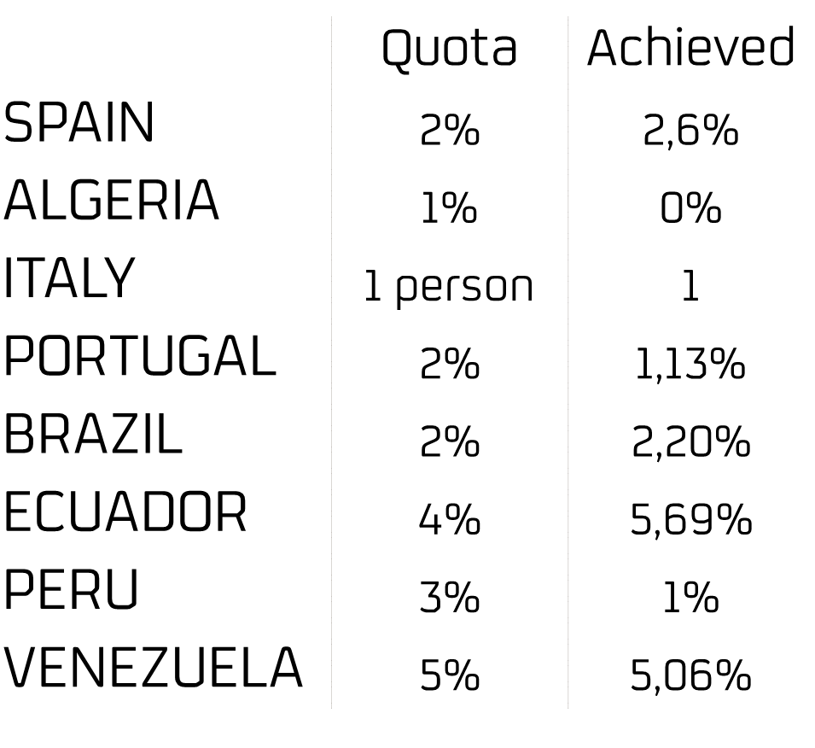
People with disabilities. Repsol context
487
2.52%
570
Employees Spain and other countries
Direct employees Spain
Quota Spain
2,3%
Quota Global 2018

Slide 10
Lessons learnt
Why is it important?
Commitment of top management
Whom should we involve? Who can share support or information? Who will be affected?
Coordinate all stakeholders
Any support from experts? Spread the word: foundations, government agencies, institutions of reference.
Cooperate with expert bodies
Manage the process based on numbers, not opinions
Get support from quantitative data
Where do we want to be? Does it make sense for our business? How will we know that we are on right track? How will it be when we reach the goal?
Strategic planning
Create proper conditions
Any obstacles we need to manage? Accessibility, training, raising awareness, communication…
Follow-up, learning from mistakes, giving up paternalism
Continuous improvement

Slide 11
Four Examples
Ask them!
Job profile
Continues awareness
Redistribute the tasks in the team
Adapt the processes and tools
Internal seminars lead by people already integrated
Don’t be biased
Almost any match will be possible
Notes:
Alba blind, she is a recruiter
Patricia blind working with videos going to work by metro

Slide 12
Learn more from Repsol publications
Notes:
Because we think that disabilities is a global challenge, we want to share all our experience about it.
We have published three white papers publications that you will find in our corporative website Repsol.com.
From left to right:
A guide of how to create Service stations accesible to all disabilities
Diverse talent that collect our experience in many different busineses and how we linked this project with every Business strategy
And the guide “Overcomming Barriers” that shows our experience in adapting workplaces to all disabilities
All of them are available in English and Spanish for free in our website.

Slide 13
Video (1 minute)
Notes:
This is a short video that represent what we think about people with disabilities

Slide 14
THANK YOU
Q&A
Notes:
In my experience, we must customize and adapt our organization to the people. Learn how to do it and how you will treat each person allow you to understand what diversity means. This kind of organizations will allow the people to have safer and healthier workplaces and also, to have greater results!
Thank you!

